Slide 1
CLASS
Mrs. Potter - 8th Grade Video Tech

Slide 2
Daily Requirements
CHECK GOOGLE CLASSROOM & SCHOOL EMAIL DAILY
.

Slide 3
Participation
On time to class and ready to work
Actively participate in activities and discussions

Slide 4
Be On Time
Logged In
Ready To Work and Participate
Excessive Lates or Leaving Class Early will contain consequences

Slide 5
Participation
Class Participation is a grade
Disrupting the class in any manner will not be tolerated
Continual disruptions will result in loss of participation points and phone calls home.

Slide 6
Grading Policy
50% Project Assessments
30% Classwork
20% Weekly Participation

Slide 7
Grading Policy
All rules, policies, grading information, assignments, instructions and due dates will be available in Google Classroom.
Be sure to review all rubrics and requirements carefully prior to submitting work. I am grading the first submission. There will be no corrections or resubmissions.

Slide 8
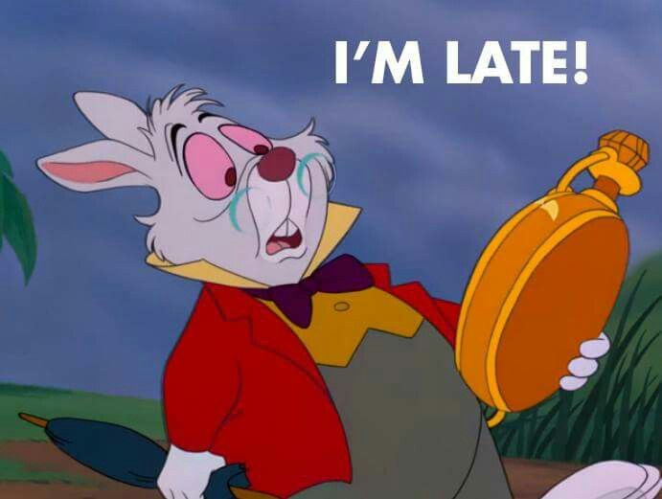
Grading Policy
Plagiarism is strictly enforced and will result in a 10 point deduction
Plagiarized work will be given 2 days to correct and resubmit
Late work will result in a 5-10 point deduction
Late work will not be accepted after one week of the initial due date.

Slide 9
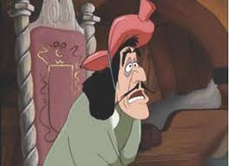
Absent Policy
Any student that misses class for scheduled lessons, testing, field trips or other school activities is responsible for making up all work and meeting all required deadlines.
If you are absent from school, check Google Classroom for missed assignments.

Slide 10
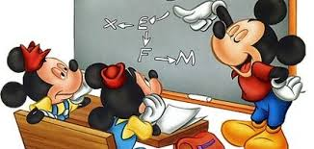
Extra Help
Check Google Classroom
If you need individual Extra Help email me so we can confirm times
You may be personally invited to attend Extra Help

Slide 11
We are in this TOGETHER!
Reach out if you need anything!
dapotter@jacksonsd.org

